Slide 1

Wine Retailer Case
Group 9:
Anjali Shastri
Futao Xie
Guchuan Qiu
Huiwen Ge
Tianbi Guo

Slide 2

Highlights/Summary
Average causal effect shows an effect size of 1.35 and all variables are highly significant.
Slicing and dicing analysis shows the email campaign is not effective at targeting different segments.
Casual forest is an optimal tool to predict individual score.

Slide 3
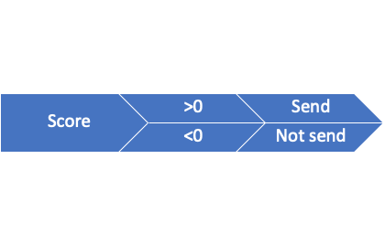
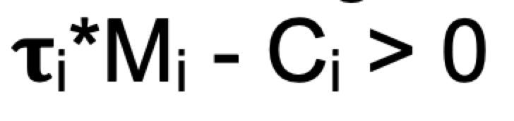
Methodology
Criteria:
Uplift difference
Margin=0.3
Email cost=0.1
Targeting Rules:
Slice and Dice Analysis: Importance of Variables
2 methods
Causal Forest: Whom should receive the email

Slide 4
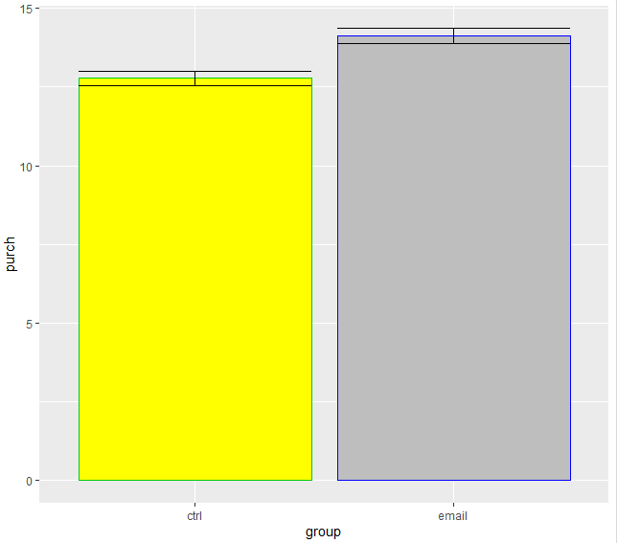
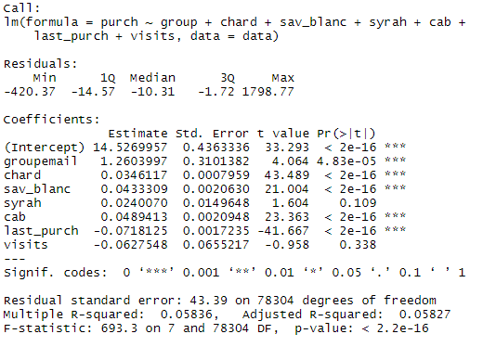
Evaluation – Average Causal Effect
Email group shows higher purchase than the control group – one that does not receive emails
Other important variables that affect purchase are type of wine and last purchase

Slide 5
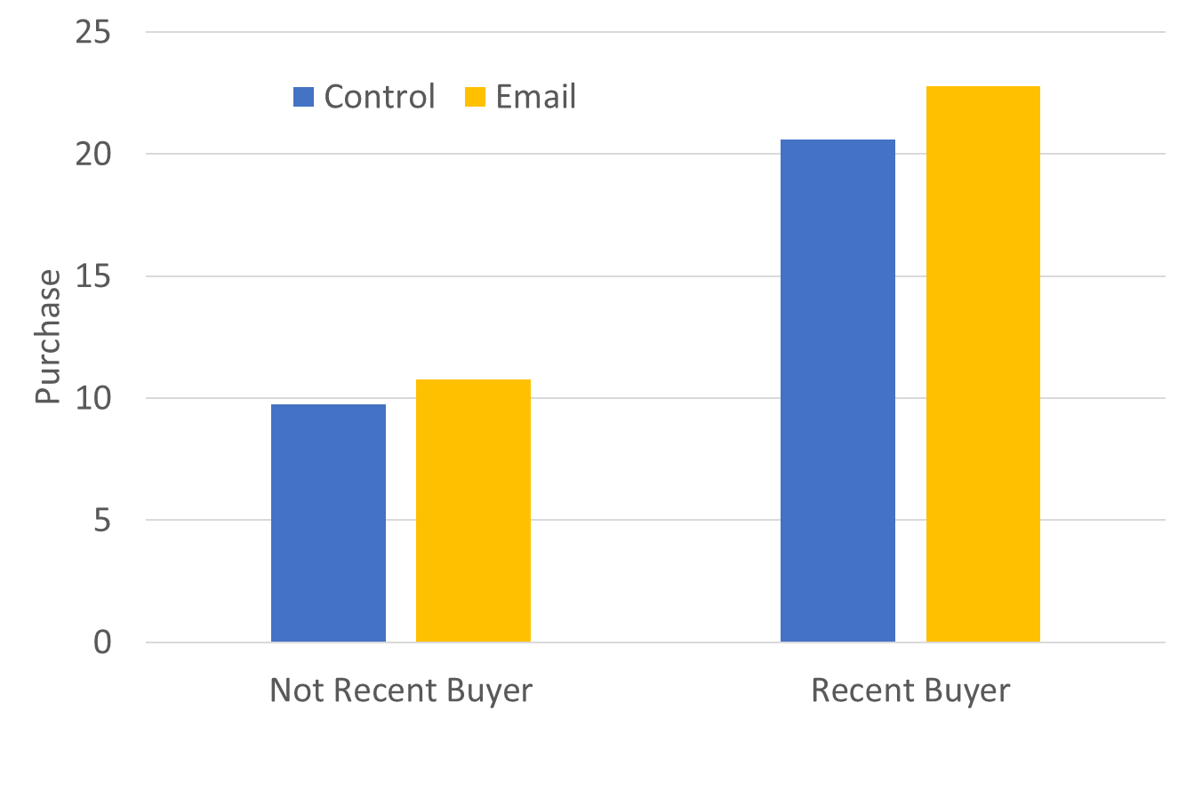
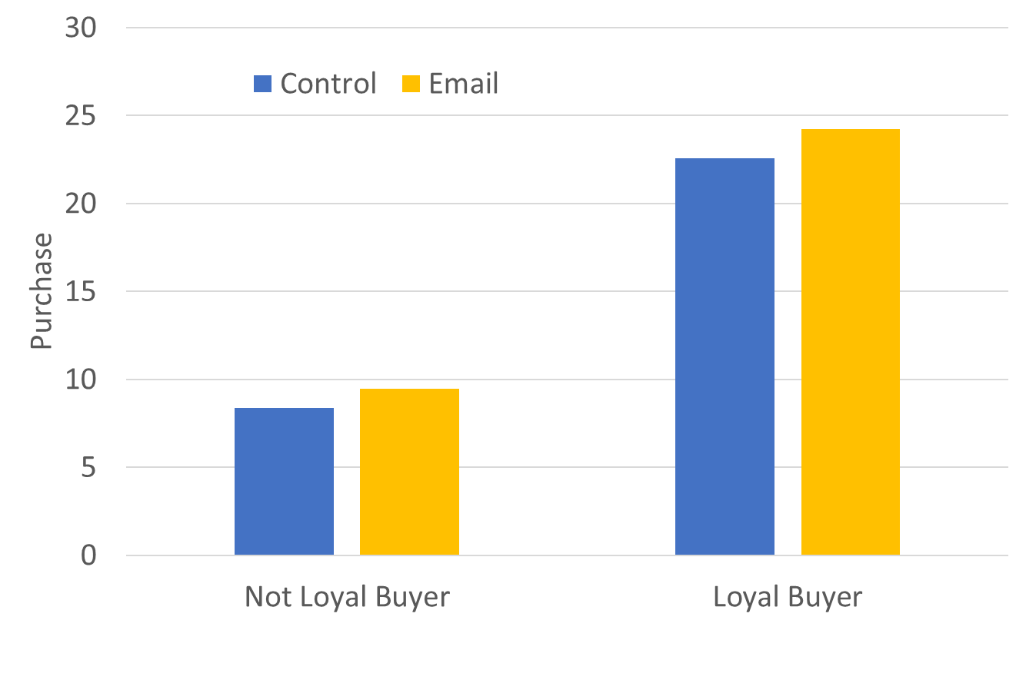
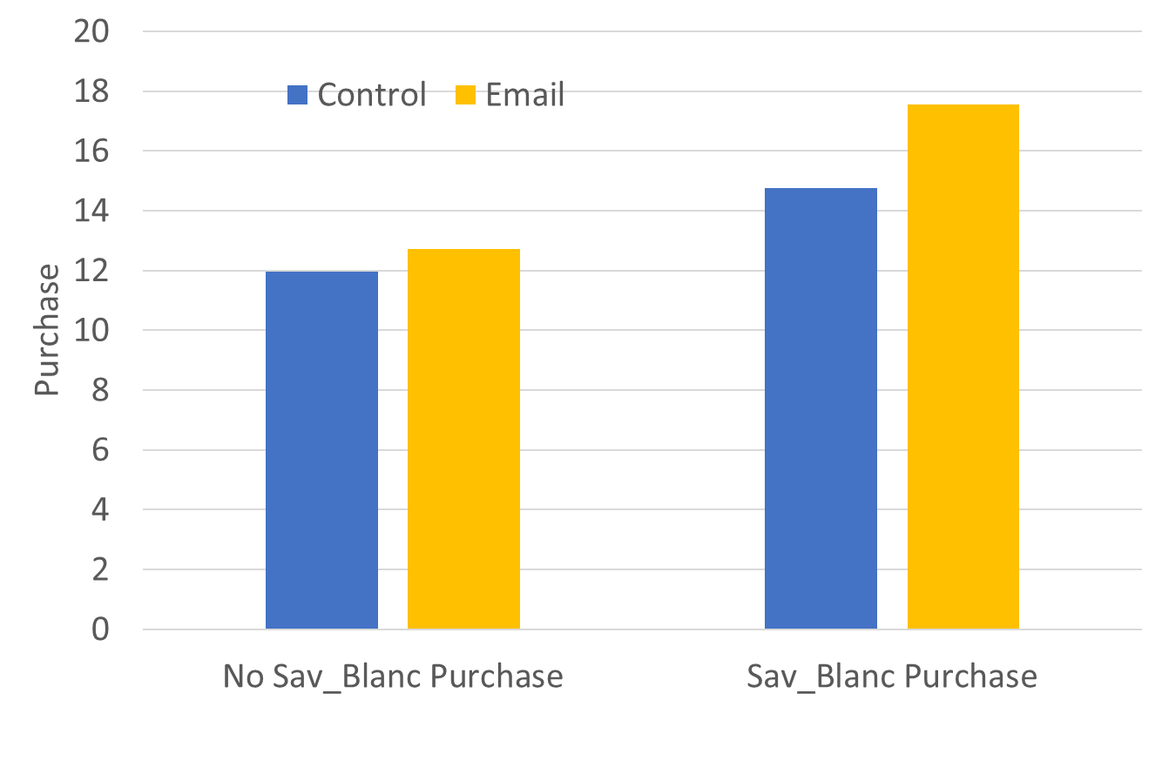
Slice and Dice Analysis
email*recentPurch
recentPurch: last_purch<30
Coefficients of interaction 1.19
email*loyalBuyer
loyalBuyer: past_purch>130
email*sav_blanc_or not
Sav_blanc_or_not: sav_blanc>0
Coefficients of interaction 0.54
Significance: 0.43
Significance: 0.09
Coefficients of interaction 2.05
Significance: 0.004
Suggestions for email campaign targeting
Customers within 30 days
Customers spent more than average
Customers purchased Sauvignon Blanc
Numbers of visits and other 3 brands purchase history are relatively unessential.

Slide 6
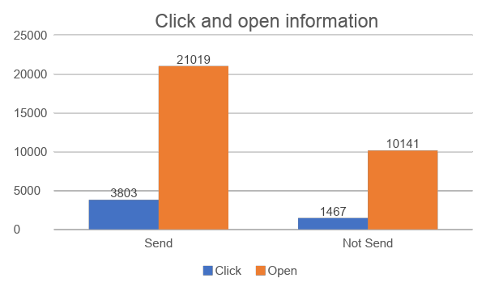
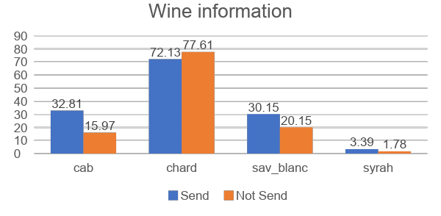
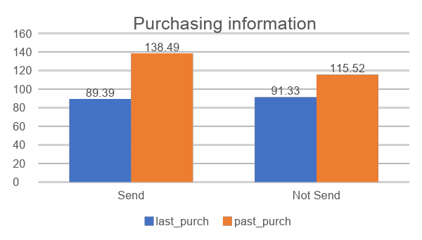
Summary: Targeted Customer Set
Number of trees | 2000
Training group size | Entire Dataset
Percentage of sending email | 65.66%
Average Treatment Effect | Estimate |  | 1.32 | Std.err |  | 0.31
Variable Importance
chard | sav_blanc | syrah | cab | past_purch | visits | last_purch
0.16 | 0.206 | 0.047 | 0.088 | 0.294 | 0.039 | 0.165
Least important feature
Why choose casual forest: non-linear relationship
Targeting group prefer cab than non-target group
Minor difference between two groups when look at chard and syrah
Targeting group are more likely to click and open
There’s no huge gap of last purchase amount or past purchase amount between two groups

Slide 7
Q&A

Slide 8
Appendix

